Slide 1
SMART CARD ATTENDANCE
Submitted by
Sri Himaja Korrapati
1810548
Gayatri Devi Jetti
1828070
Suram Rikith Kumar Reddy
1813662

Slide 2
Objective
The smart attendance will help to mark the attendance of the students attending a particular lecture.

Slide 3
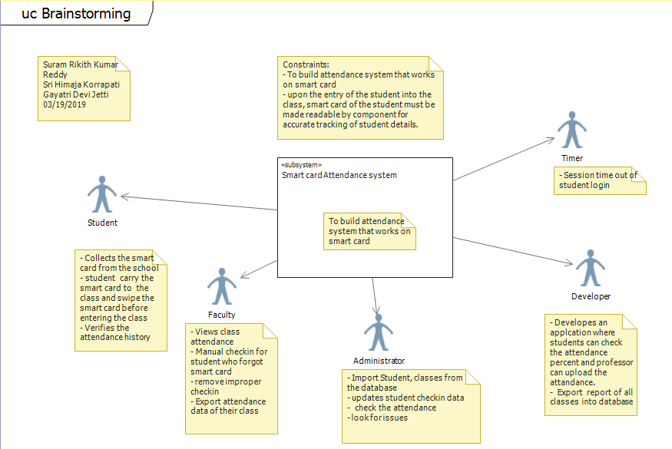
Brainstorming

Slide 4
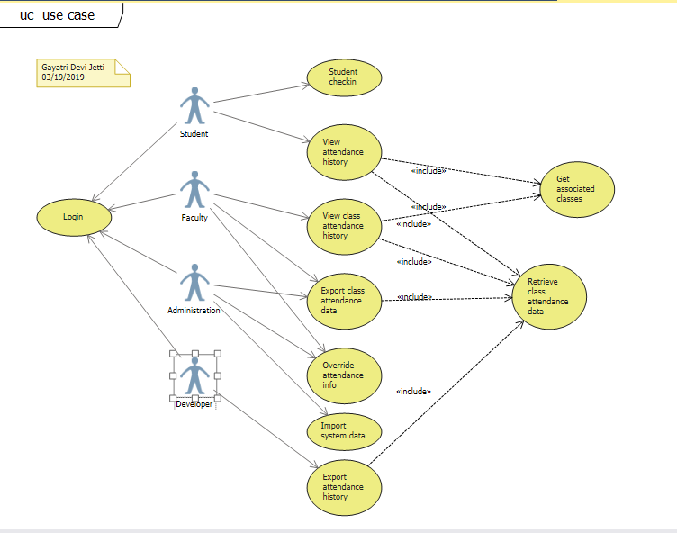
Use Case

Slide 5
Use Case
This Use cases are based on Smart card to carry out Attendance..
This use cases enables easy attendance process every time for the student.

Slide 6
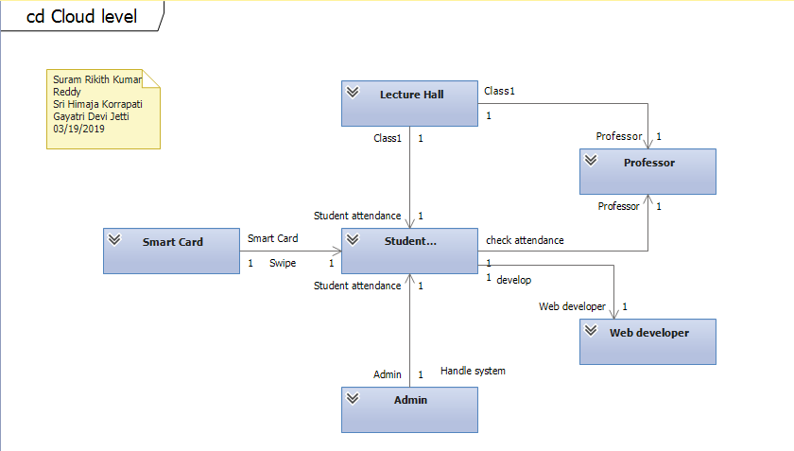
Cloud Level

Slide 7
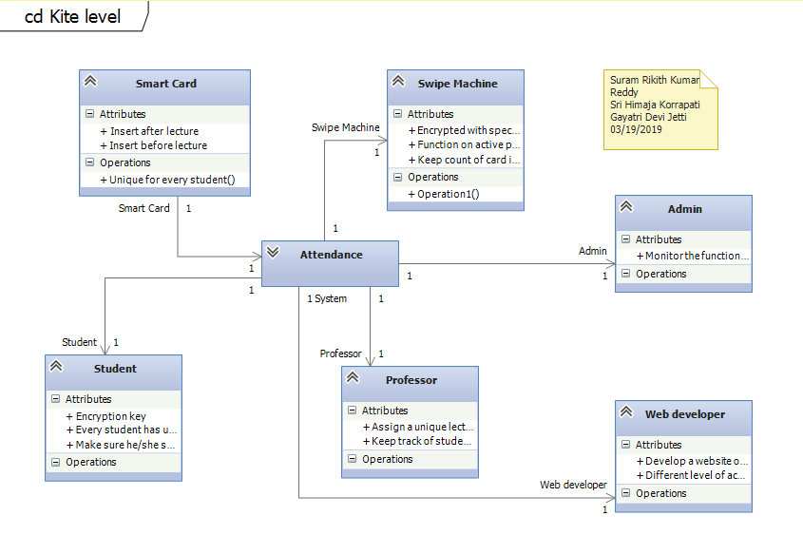
Kite Level

Slide 8
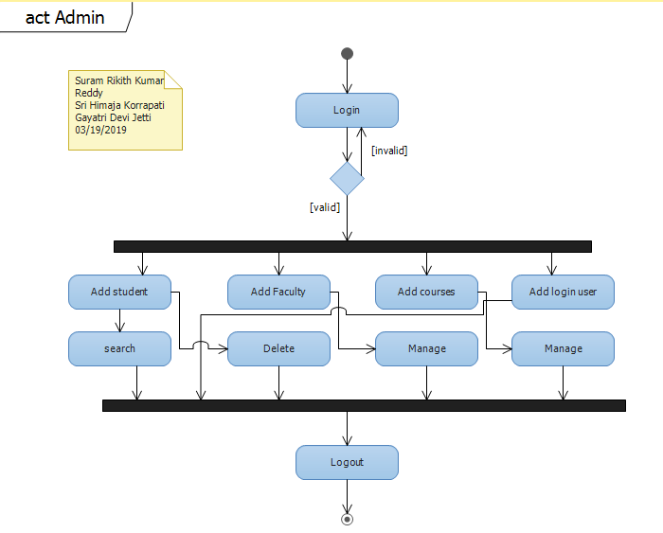
Activity

Slide 9
Activity Diagram
Activity diagram shows the procedural flow.
Alternative to state diagram.
It allows for bug fixing for the process.

Slide 10
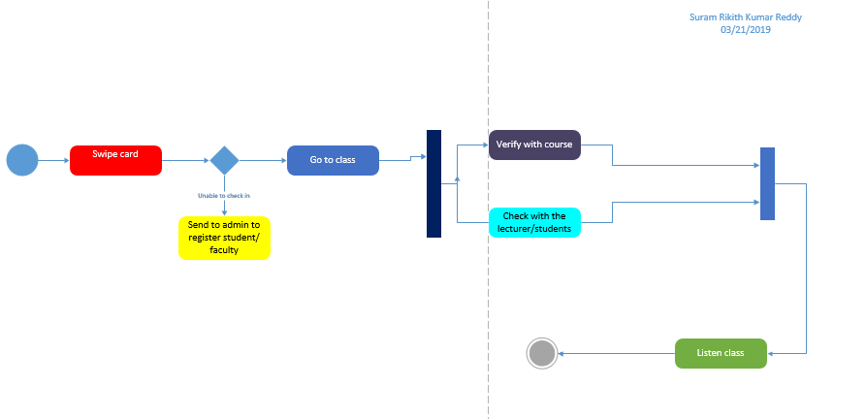
State Machine Diagram

Slide 11
State Diagram
Shows the responsibilities for change in states
Actions are displayed.
Functionalities are updated.

Slide 12
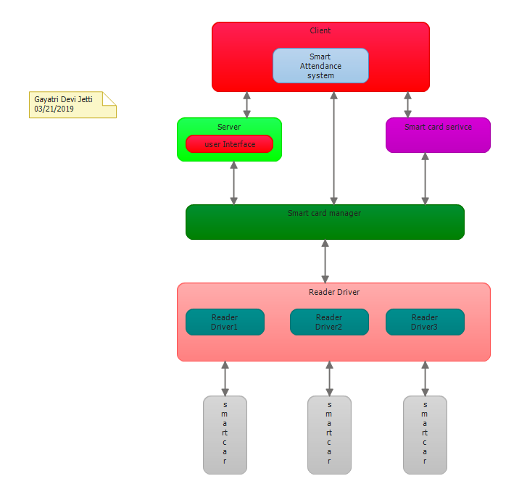
Layer

Slide 13
Layer Diagram
Represent separate functional areas of the system.
Responsibilities of all areas are defined.

Slide 14
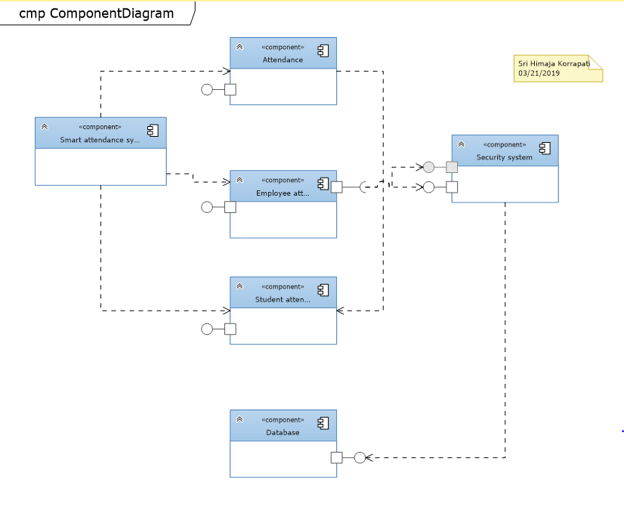
Component

Slide 15
Component
Relationship between interfaces and ports are displayed
The main concept of the system is shown.

Slide 16
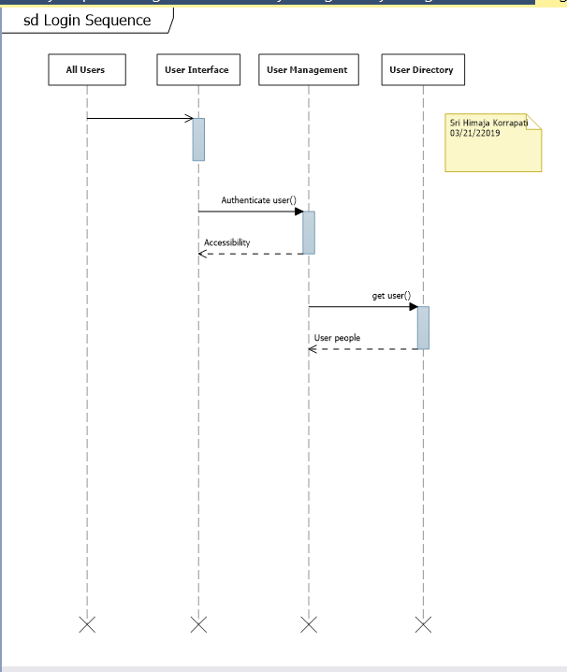
Sequence

Slide 17
Sequence Diagram
Interaction between actors and system are displayed clear.
Core methods and classes are at the beginning of the form.

Slide 18
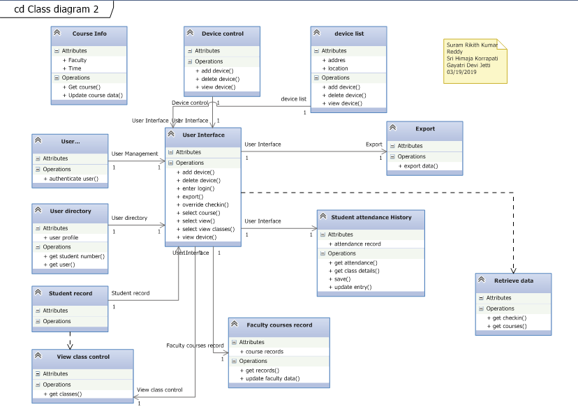
Class

Slide 19
Class Diagram
Describes the different classes of the system and relationships.
Smart card features are shaped.

Slide 20
Conclusion
Smart card is used for marking attendance in educational institutions where attendance management is itself a time consuming and cumbersome process.
It will make the attendance system smooth and reliable.

